Slide 1


Intermediate Python
Operator Overloading

Slide 2
Operator Overloading: The Big Idea
Operator overloading allows objects to behave like built-in Python types.
Operators map to special “dunder” methods
Improves readability of object interactions
Makes domain objects intuitive to use
Widely used in Python libraries
Must follow expected behavior
Notes:
Explain that operator overloading is not magic—it’s just method calls. Emphasize clarity over cleverness.

Slide 3
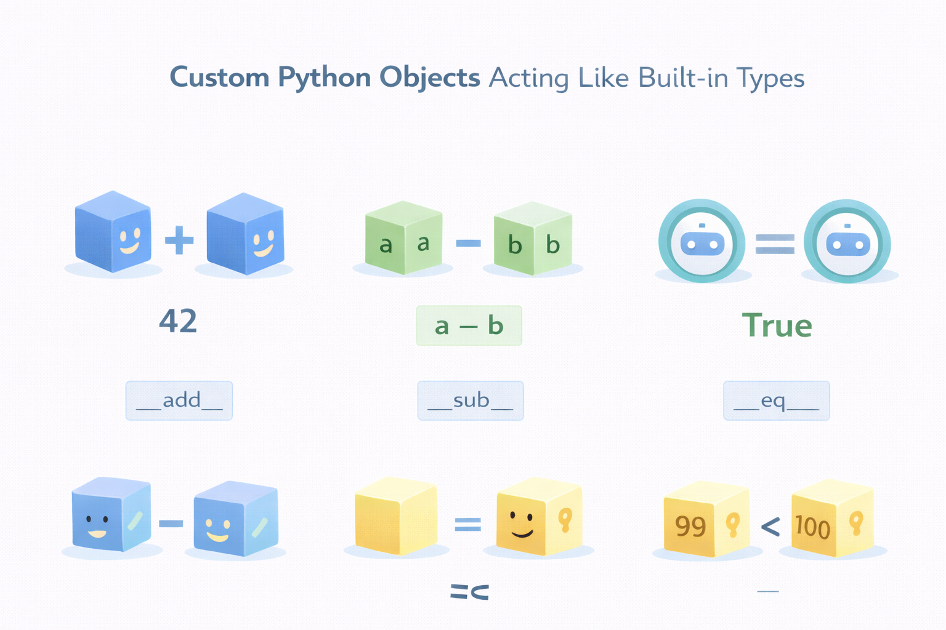

Slide 4
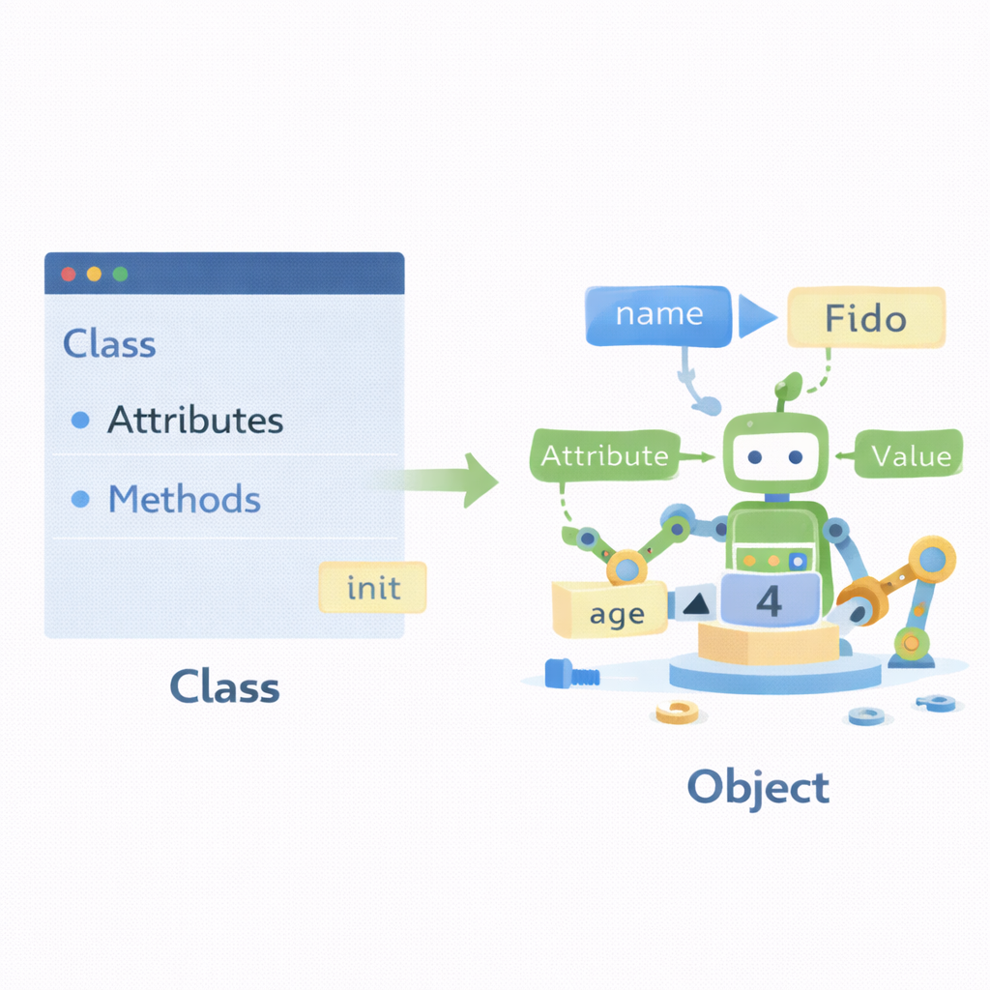
Object Initialization with __init__
__init__ defines how an object starts its life.
Automatically called during object creation
Assigns initial attribute values
Can enforce validation rules
Establishes class invariants
Foundation for all other operators
Notes:
Clarify that __init__ initializes, not creates, the object. Good initialization prevents downstream bugs.

Slide 5
Source code example
class Money:
def __init__(self, amount: float, currency: str = "MYR"):
if amount < 0:
raise ValueError("amount must be non-negative")
self.amount = float(amount)
self.currency = currency

Slide 6

Arithmetic Operators: __add__ and __sub__
Arithmetic operators let objects participate in math-like expressions.
+ calls __add__
- calls __sub__
Should return new objects
Avoid mutating existing objects
Behavior must be predictable
Notes:
Stress immutability as a good practice. Mention that += behaves differently if __iadd__ exists.

Slide 7
Source code Example
class Money:
def __init__(self, amount: float, currency: str = "MYR"):
self.amount = float(amount)
self.currency = currency
def __add__(self, other):
if not isinstance(other, Money):
return NotImplemented
if self.currency != other.currency:
raise ValueError("currency mismatch")
return Money(self.amount + other.amount, self.currency)

Slide 8
Source code Example (2)
def __sub__(self, other):
if not isinstance(other, Money):
return NotImplemented
if self.currency != other.currency:
raise ValueError("currency mismatch")
return Money(self.amount - other.amount, self.currency)

Slide 9
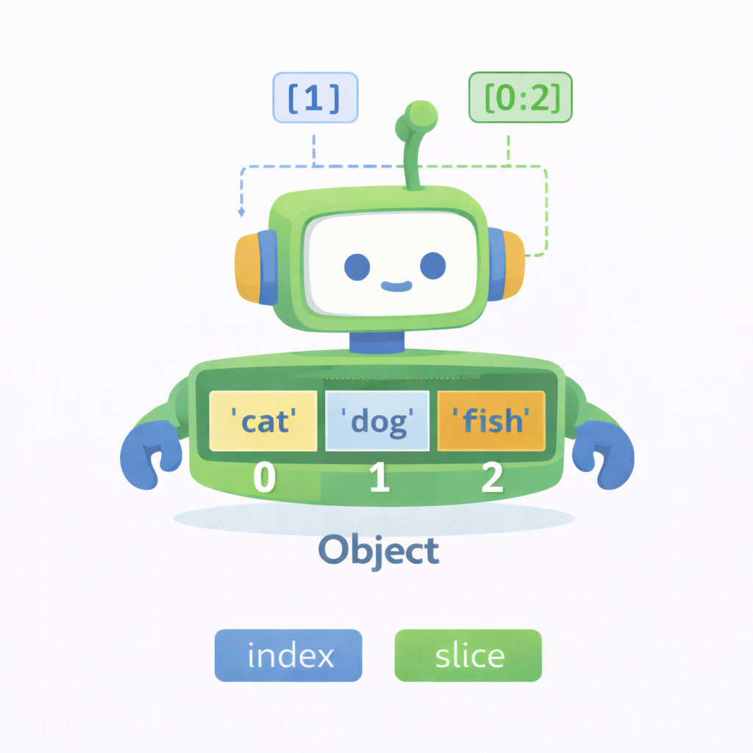
Indexing & Slicing (__getitem__)
Indexing makes objects behave like sequences.
obj[i] triggers __getitem__
Supports integer indexing
Supports slicing via slice objects
Improves API usability
Common in containers and datasets
Notes:
Explain that slices are passed as slice(start, stop, step). One method handles both indexing and slicing.

Slide 10
Source code example
class Scores:
def __init__(self, values):
self._values = list(values)
def __getitem__(self, index):
return self._values[index] # works for int OR slice
def __len__(self):
return len(self._values)
s = Scores([80, 90, 85, 70])
print(s[1]) # 90
print(s[1:3]) # [90, 85]

Slide 11
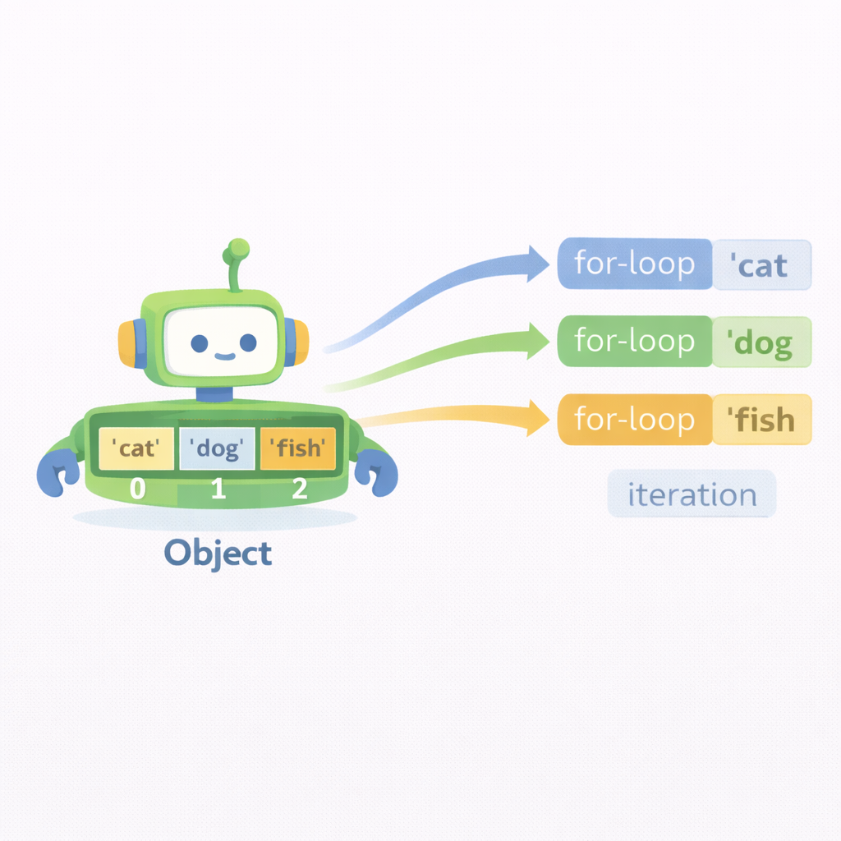
Iteration Protocol (__iter__)
Iteration methods allow objects to work with for loops.
__iter__() returns an iterator
Enables use in for loops
Works with list(), sum(), any()
Often delegates to internal data
Essential for container objects
Notes:
Explain that most classes simply return iter(self.items). Manual iterators are for advanced cases.

Slide 12
Source code example
class Bag:
def __init__(self, items):
self._items = list(items)
def __iter__(self):
return iter(self._items)
b = Bag(["pen", "book", "eraser"])
for item in b:
print(item)

Slide 13
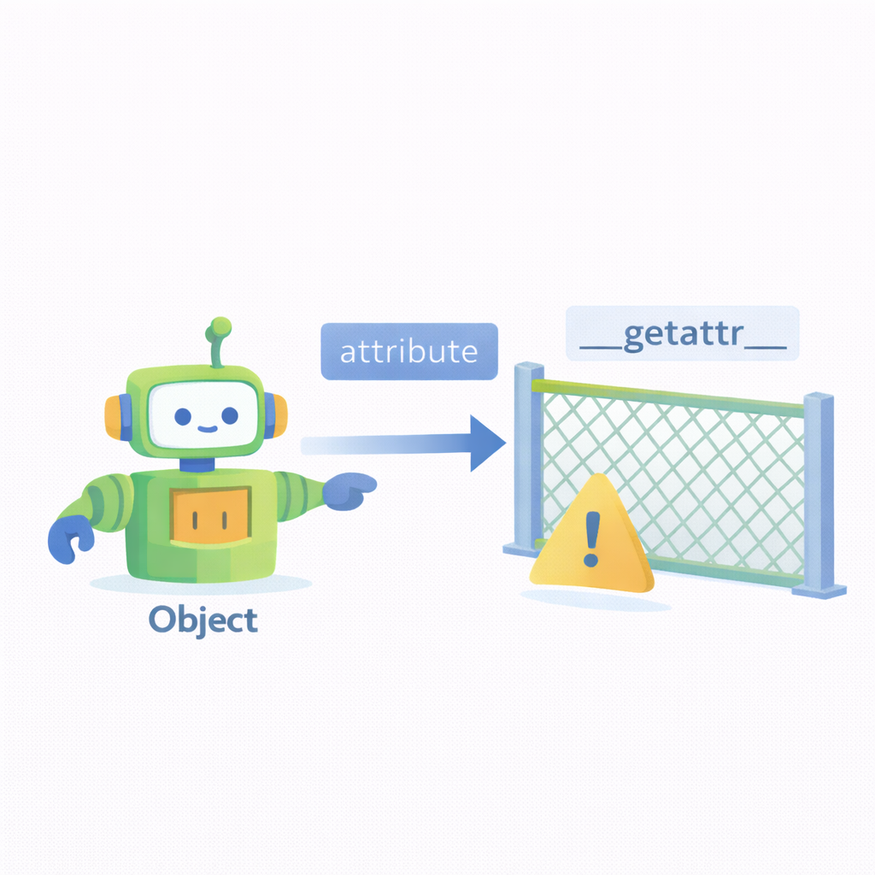
Attribute Interception (__getattr__, __setattr__)
Attribute interception customizes how attributes are accessed or assigned.
__getattr__ runs when attribute is missing
__setattr__ intercepts assignments
Useful for proxies and lazy loading
Powerful but risky
Can easily cause recursion bugs
Notes:
Strongly warn students this is advanced. Always use super().__setattr__ to avoid recursion.

Slide 14
Source code example
class SafeConfig:
def __init__(self):
self._data = {}
def __getattr__(self, name):
# only called if normal lookup fails
return self._data.get(name, None)
def __setattr__(self, name, value):
if name == "_data":
super().__setattr__(name, value)
else:
self._data[name] = value
cfg = SafeConfig()
cfg.theme = "dark"
print(cfg.theme) # dark
print(cfg.unknown) # None

Slide 15

Comparison Operators (__eq__, __lt__, etc.)
Comparison operators define how objects are compared and sorted.
== uses __eq__
< uses __lt__
Enables sorting and searching
Must be logically consistent
Reflects domain meaning
Notes:
Mention sorted() and .sort() rely on comparison methods. Introduce functools.total_ordering briefly.

Slide 16
Source Code Example
class Student:
def __init__(self, name, score):
self.name = name
self.score = score
def __eq__(self, other):
if not isinstance(other, Student):
return NotImplemented
return self.score == other.score
def __lt__(self, other):
if not isinstance(other, Student):
return NotImplemented
return self.score < other.score
students = [Student("Aina", 90), Student("Ali", 75)]
print(sorted(students)) # works because __lt__ exists

Slide 17
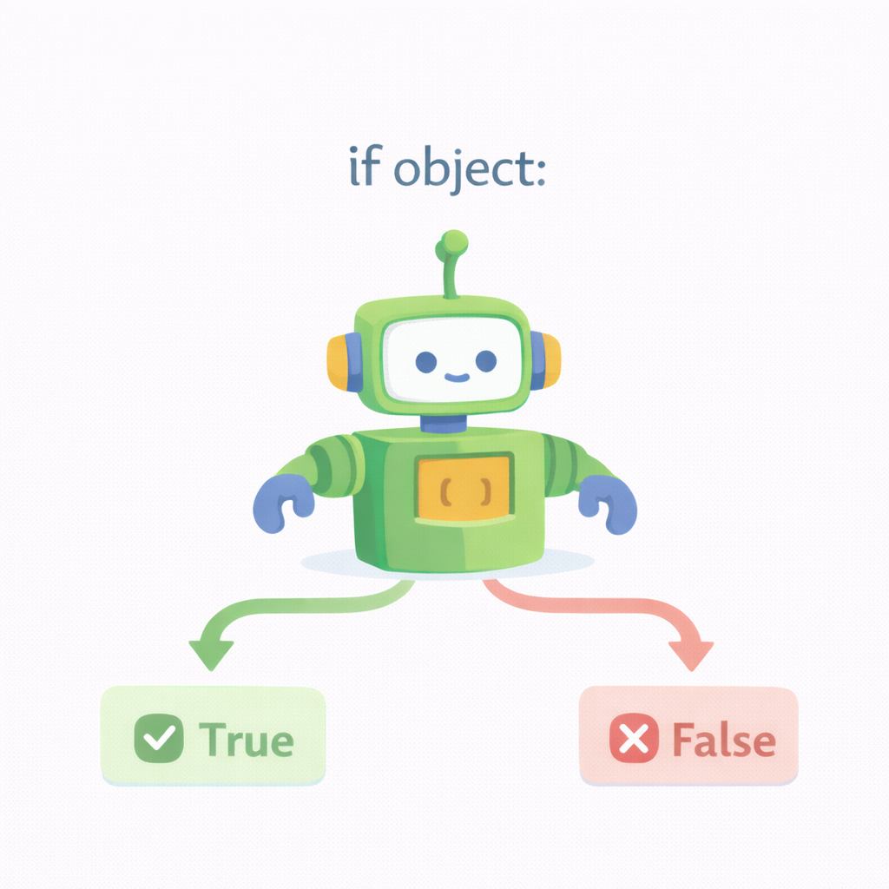
Boolean Operators (__bool__ and __len__)
Boolean methods control truthiness of objects.
if obj: calls __bool__
Falls back to __len__
Defines “empty” vs “non-empty”
Common in containers
Must return True or False
Notes:
Explain why empty lists evaluate to False. Encourage intuitive truth conditions.

Slide 18
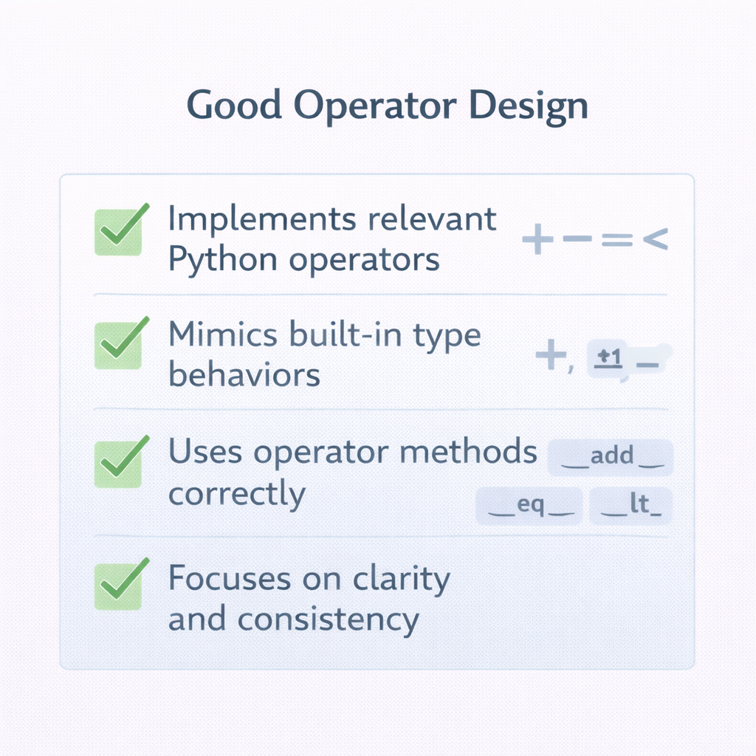
Design Rules for Operator Overloading
Good operator overloading follows user expectations.
Match built-in Python behavior
Avoid surprising side effects
Prefer readability
Document overloaded operators
Use operators sparingly
Notes:
If an operator needs explanation, use a method instead.

Slide 19
Summary
Operator overloading makes objects expressive and Pythonic.
Operators map to dunder methods
Arithmetic, indexing, iteration are common
Attribute interception is advanced
Comparisons and booleans improve usability
Design discipline is essential
Notes:
Bridge to next session: advanced class design and patterns. Reinforce “clarity first” mindset.

